Slide 1
Brazilian E-Commerce Dashboard
Power BI Project Performance & Strategic Insights
Prepared by: Rongali Sandeep Naidu

Slide 2
Project Scope & Dataset Overview
Project Objective:
To systematically analyze customer behavioral patterns, regional sales performance, core product categories, and transaction mechanisms into interactive, actionable business intelligence.
Dataset Components:
• Orders Data: Transaction records, timestamps, and fulfillment metrics.
• Customer Profiles: Unique identifiers and geographic locations across states.
• Product Categories: Granular item categorization and revenue metrics.
• Payment Information: Breakdown of methods (Credit Card, Boleto, Voucher).

Slide 3
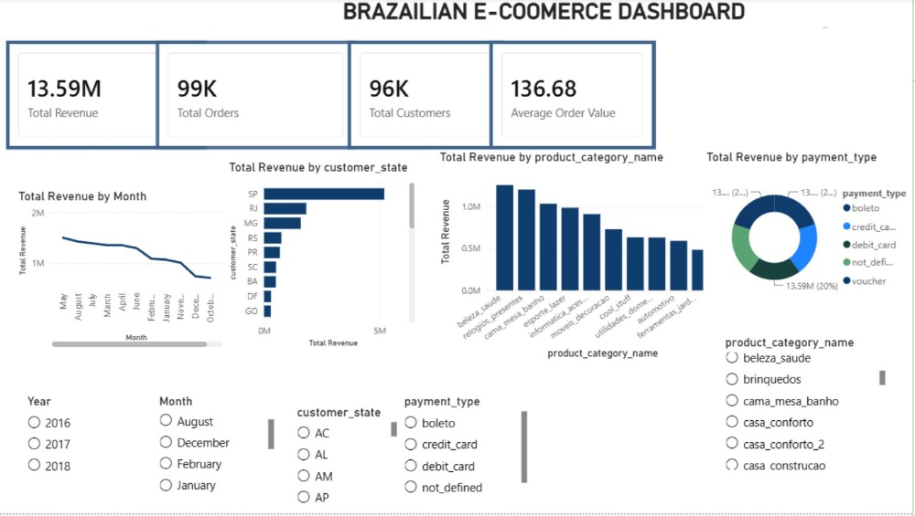
Interactive Power BI Dashboard Interface

Slide 4
Core Performance Benchmarks (KPIs)
• Total Revenue: 13.59M (Gross transactional value across all Brazilian states)
• Total Orders: 99K (Total successfully processed marketplace retail purchases)
• Total Customers: 96K (Unique registered buyers active across the platform)
• Average Order Value (AOV): 136.68 (Average financial amount spent per unique order transaction)

Slide 5
Data-Driven Business Insights
• Regional Concentration: São Paulo (SP) stands out as the primary commercial hub, contributing the overwhelming majority of aggregate revenue.
• Category Dominance: The 'Beleza & Saúde' (Beauty & Health) segment represents the platform's highest-grossing product category.
• Checkout Optimization: Credit Cards and Boleto Bancário emerge as the absolute preferred customer payment mechanisms.
• Cyclical Revenue Drop: Historical performance data displays a visible downward trend toward the final quarter of the year requiring seasonal promotions.

Slide 6
Strategic Roadmap & Recommendations
• Targeted Supply Chain Allocation: Allocate robust fulfillment infrastructure to São Paulo to guarantee hyper-fast local delivery times.
• Inventory Expansion: Scale inventory depths for top-performing product categories (e.g., Beauty & Health) ahead of peak quarters.
• Flexible Payment Options: Partner with transaction processors to provide promotional cashback or zero-interest installments for Credit Card and Boleto users.
• Q4 Campaign Engineering: Introduce proactive promotional calendars, flash sales, and customer re-engagement pipelines by late Q3 to buffer the historical end-of-year deceleration.

